Slide 1
Convolutional Neural Network – II
Model Architectures
Lecture 4
Part 2
Generative AI for Computer Vision

Slide 2
Content
CNN Architectures
LeNet
AlexNet
VGG Net
Google Net
  Inception Module

Slide 3
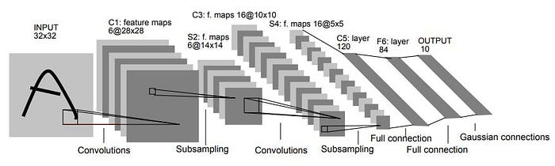
LeNet – 5
[LeCun et al., 1998]
LeNet, introduced by Yann LeCun and colleagues in 1998, is one of the earliest successful convolutional neural network (CNN) architectures for handwritten digit recognition.
The most well-known version, LeNet-5, consists of seven trainable layers: an input layer that accepts a 32 × 32 grayscale image, followed by two convolutional layers (C1 and C3) that extract local image features using learnable filters, with each convolutional layer followed by an average pooling (subsampling) layer (S2 and S4) to reduce spatial dimensions and improve robustness.
Image Source : https://medium.datadriveninvestor.com/lenet-5-a-classic-cnn-architecture-c87d0b03560d

Slide 4
LeNet – 5
[LeCun et al., 1998]
After feature extraction, the network includes a fully connected layer (C5), another fully connected layer (F6), and an output layer with 10 neurons representing the digit classes (0–9).
LeNet employs the sigmoid or hyperbolic tangent (tanh) activation functions and uses backpropagation for training.
Its architecture demonstrated that hierarchical feature learning through convolution and pooling could achieve high accuracy while reducing the number of trainable parameters, making LeNet a foundational model that inspired modern deep convolutional neural networks.
Image Source : https://medium.datadriveninvestor.com/lenet-5-a-classic-cnn-architecture-c87d0b03560d

Slide 5
Padding
Padding in a Convolutional Neural Network (CNN) is the process of adding extra pixels (typically zeros) around the border of an input image or feature map before applying convolution.
Prevents rapid reduction in spatial dimensions and preserves important information at the image boundaries.
0
0
0
0
0
0
0
0
0
0
©
||
0
0
0
0
0
0
3x3
3x3
0
0
0
0
0
5x5

Slide 6
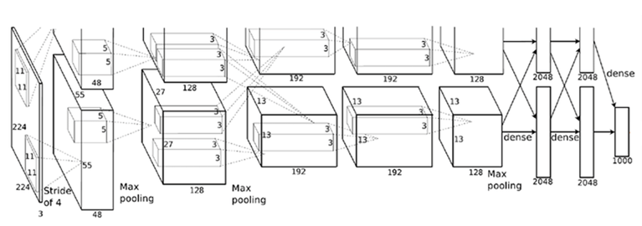
AlexNet
Krizhevsky et. al. 2012
AlexNet, proposed by Alex Krizhevsky, Ilya Sutskever, and Geoffrey Hinton in 2012, is a landmark deep convolutional neural network (CNN) architecture that significantly advanced large-scale image classification.
Designed for the ImageNet Large Scale Visual Recognition Challenge (ILSVRC), AlexNet consists of eight learnable layers, including five convolutional layers followed by three fully connected layers, with a final 1,000-node softmax output layer for classification.
From Source Paper: An illustration of the architecture of our CNN, explicitly showing the delineation of responsibilities between the two GPUs. One GPU runs the layer-parts at the top of the figure while the other runs the layer-parts at the bottom. The GPUs communicate only at certain layers.
Source: A. Krizhevsky, I. Sulskever, and G. E. Hinton, “ImageNet classification with deep convolutional neural networks,” Adv. Neural Inf. Process. Syst., vol. 60, no. 6, pp. 84-90, 2012.

Slide 7
AlexNet
Krizhevsky et. al. 2012
The network takes 227 × 227 × 3 RGB images as input and introduces several key innovations, including the use of Rectified Linear Unit (ReLU) activation functions for faster training, overlapping max-pooling layers for spatial down-sampling, dropout in the fully connected layers to reduce overfitting, and data augmentation techniques such as image translations and horizontal flipping to improve generalization.
AlexNet was trained using stochastic gradient descent (SGD) on GPUs, enabling efficient optimization of its approximately 60 million parameters. By achieving a substantial reduction in ImageNet classification error, AlexNet demonstrated the effectiveness of deep learning for computer vision and laid the foundation for subsequent CNN architectures such as VGGNet, GoogLeNet, and ResNet.
A. Krizhevsky, I. Sulskever, and G. E. Hinton, “ImageNet classification with deep convolutional neural networks,” Adv. Neural Inf. Process. Syst., vol. 60, no. 6, pp. 84-90, 2012.

Slide 8
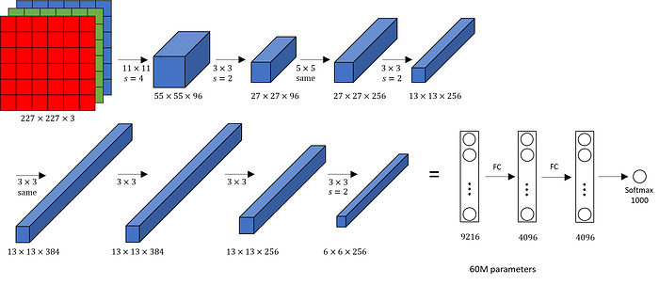
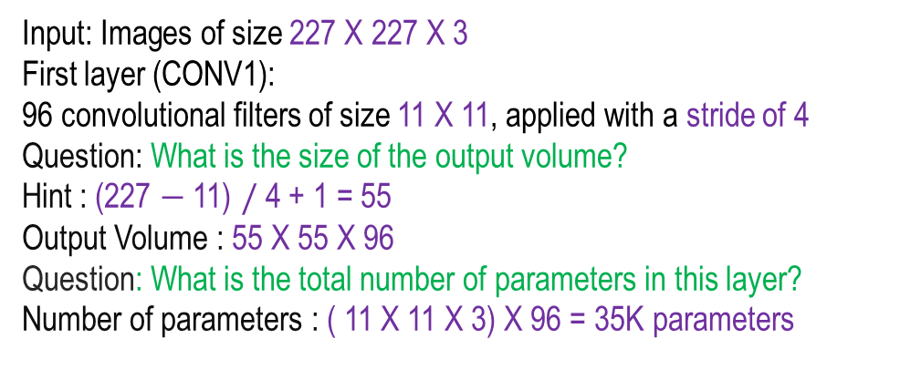
AlexNet
Krizhevsky et. al. 2012
Layer | Type | Standard Kernel/Filter Details
CONV1 | Convolution | 96 filters, 11x11 kernel, Stride 4, Pad 0
MAX POOL1 | Pooling | 3x3 kernel, Stride 2
NORM1 | Normalization | Local Response Normalization (LRN)
CONV2 | Convolution | 256 filters, 5x5 kernel, Stride 1, Padding 2
MAX POOL2 | Pooling | 3x3 kernel, Stride 2
NORM2 | Normalization | Local Response Normalization (LRN)
CONV3 | Convolution | 384 filters, 3x3 kernel, Stride 1, Padding 1
CONV4 | Convolution | 384 filters, 3x3 kernel, Stride 1, Padding 1
CONV5 | Convolution | 256 filters, 3x3 kernel, Stride 1, Padding 1
MAX POOL3 | Pooling | 3x3 kernel, Stride 2
FC6 | Fully Connected | 4096 neurons (typically with Dropout)
FC7 | Fully Connected | 4096 neurons (typically with Dropout)
FC8 | Fully Connected | 1000 neurons (Class scores/ Softmax)
Input: Images of size 227 X 227 X 3
First layer (CONV1):
96 convolutional filters of size 11 X 11, applied with a stride of 4
Question: What is the size of the output volume?
Hint : (227 $−$ 11) $/$ 4 + 1 = 55
Output Volume : 55 X 55 X 96
Question: What is the total number of parameters in this layer?
Number of parameters : ( 11 X 11 X 3) X 96 = 35K parameters
Slide idea: Fei Fei Li, Stanford Lectures, Image Source : https://medium.com/@siddheshb008/alexnet-architecture-explained-b6240c528bd5

Slide 9
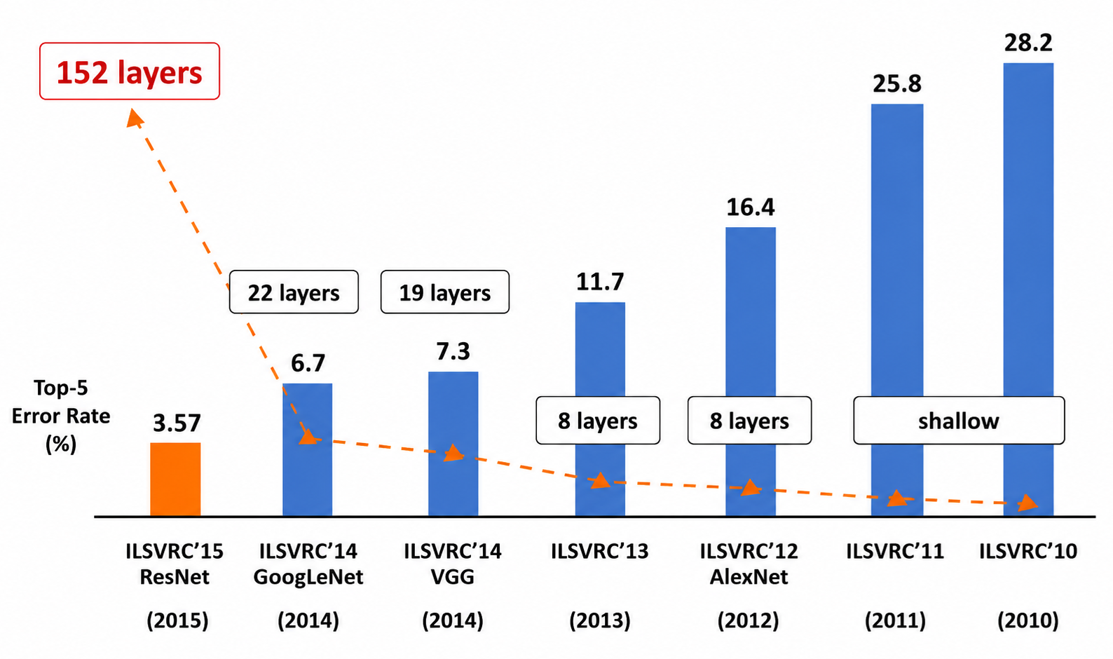
First CNN based winner
ImageNet Large Scale Visual Recognition Challenge (ILSVRC) winners
Image Source : Hu, Hanqing & Lyu, Jin & Yin, Xiaolin. (2020). Research and Prospect of Image Recognition Based on Convolutional Neural Network. Journal of Physics: Conference Series. 1574. 012161. 10.1088/1742-6596/1574/1/012161.

Slide 10
Deeper Network
ImageNet Large Scale Visual Recognition Challenge (ILSVRC) winners
Image Source : Hu, Hanqing & Lyu, Jin & Yin, Xiaolin. (2020). Research and Prospect of Image Recognition Based on Convolutional Neural Network. Journal of Physics: Conference Series. 1574. 012161. 10.1088/1742-6596/1574/1/012161.

Slide 11
VGG Net
Simonyan and Zisserman 2014
VGGNet
INPUT
3 X 3 conv + Relu 64
224 X 224
3 X 3 conv + Relu 64
2 X 2 Max – Pool 64
VGGNet, proposed by Karen Simonyan and Andrew Zisserman in 2014, is a deep convolutional neural network (CNN) architecture designed to improve image classification performance by increasing network depth while using a simple and uniform design.
The most widely used variants, VGG-16 and VGG-19, contain 16 and 19 learnable layers, respectively, composed of multiple 3 × 3 convolutional layers with a stride of 1 and padding to preserve spatial dimensions, interleaved with 2 × 2 max-pooling layers that reduce the feature map size.
3 X 3 conv + Relu 128
112 X 112
3 X 3 conv + Relu 128
2 X 2 Max – Pool 128
3 X 3 conv + Relu 256
3x3 Conv + ReLU 64
56 X 56
3 X 3 conv + Relu 256
3 X 3 conv + Relu 256
3x3 Conv + ReLU 64
2 X 2 Max – Pool 256
2x2 Max-Pool 64
3 X 3 conv + Relu 512
28 X 28
3 X 3 conv + Relu 512
3 X 3 conv + Relu 512
2 X 2 Max – Pool 512
3 X 3 conv + Relu 512
14 X 14
3 X 3 conv + Relu 512
3 X 3 conv + Relu 512
2 X 2 Max – Pool 512
7 X 7
FC 4096
FC 4096
FC Output 1000
Figure source: Fei Fei Li et. al. Stanford
OUTPUT

Slide 12
VGG16Net
INPUT
VGG19Net
INPUT
VGG Net
Simonyan and Zisserman 2014
3 X 3 conv + Relu 64
3 X 3 conv + Relu 64
224 X 224
3 X 3 conv + Relu 64
3 X 3 conv + Relu 64
224 X 224
2 X 2 Max – Pool 64
2 X 2 Max – Pool 64
3 X 3 conv + Relu 128
3 X 3 conv + Relu 128
The network accepts 224 × 224 × 3 RGB images as input and concludes with three fully connected layers, where the final layer uses a softmax classifier for output prediction.
VGGNet employs Rectified Linear Unit (ReLU) activation functions throughout the network, enabling efficient training and improved convergence.
By demonstrating that deeper networks with small convolutional filters can achieve superior recognition accuracy, VGGNet achieved outstanding performance on the ImageNet dataset and became a widely adopted feature extractor and benchmark architecture for numerous computer vision applications, despite its relatively high computational cost and large number of parameters.
112 X 112
3 X 3 conv + Relu 128
3 X 3 conv + Relu 128
112 X 112
2 X 2 Max – Pool 128
2 X 2 Max – Pool 128
3 X 3 conv + Relu 256
3 X 3 conv + Relu 256
3 X 3 conv + Relu 256
3 X 3 conv + Relu 256
56 X 56
56 X 56
3 X 3 conv + Relu 256
3 X 3 conv + Relu 256
2 X 2 Max – Pool 256
3 X 3 conv + Relu 256
2 X 2 Max – Pool 256
3 X 3 conv + Relu 512
3 X 3 conv + Relu 512
28 X 28
3 X 3 conv + Relu 512
3 X 3 conv + Relu 512
28 X 28
3 X 3 conv + Relu 512
3 X 3 conv + Relu 512
2 X 2 Max – Pool 512
3 X 3 conv + Relu 512
2 X 2 Max – Pool 512
3 X 3 conv + Relu 512
3 X 3 conv + Relu 512
14 X 14
3 X 3 conv + Relu 512
3 X 3 conv + Relu 512
3 X 3 conv + Relu 512
3 X 3 conv + Relu 512
14 X 14
2 X 2 Max – Pool 512
3 X 3 conv + Relu 512
7 X 7
2 X 2 Max – Pool 512
FC 4096
FC 4096
7 X 7
FC 4096
FC 4096
FC Output 1000
FC Output 1000
Figure source: Fei Fei Li et. al. Stanford
OUTPUT
OUTPUT

Slide 13
VGG Net
Simonyan and Zisserman 2014
A key design principle of VGGNet is the use of stacked 3 × 3 convolutional layers instead of larger convolutional filters.
Specifically, three consecutive 3 × 3 convolutional layers with a stride of 1 provide the same effective receptive field as a single 7 × 7 convolutional layer, allowing the network to capture equivalent spatial context while using a more efficient architecture.
This design offers two major advantages.
First, increased non-linearity: each 3 × 3 convolution is followed by a ReLU activation function, so stacking three such layers introduces three non-linear transformations instead of one, enabling the network to learn more complex, hierarchical, and discriminative feature representations.
Second, parameter efficiency: replacing a single 7 × 7 convolution with three 3 × 3 convolutions significantly reduces the number of trainable parameters.

Slide 14
Stack of 3 X 3 conv (stride 1) layers has same effective receptive field as one 7 X 7 conv layer
©
||
3 x 3
3 x 3
3 x 3
5 x 5
3 x 3
©
||
3 x 3
5 x 5
3 x 3
7 X 7

Slide 15
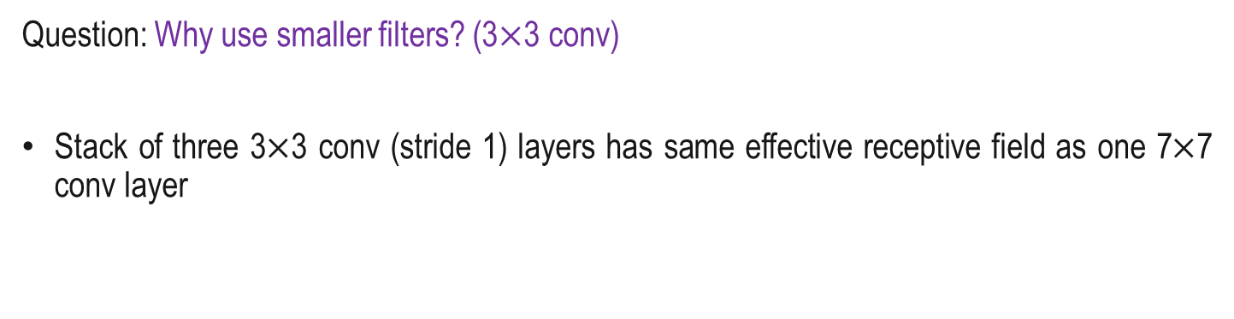
VGG Net
Simonyan and Zisserman 2014
For example, a 7 × 7 convolution requires 49 parameters per input–output channel pair, whereas three 3 × 3 convolutions require only 27 parameters (3 × 9), reducing both computational cost and the risk of overfitting while maintaining the same effective receptive field.
This combination of deeper feature extraction, enhanced representational power, and improved parameter efficiency is a fundamental reason for VGGNet's strong performance in image classification tasks.
Question: Why use smaller filters? (3$×$3 conv)
Stack of three 3$×$3 conv (stride 1) layers has same effective receptive field as one 7$×$7 conv layer

Slide 16
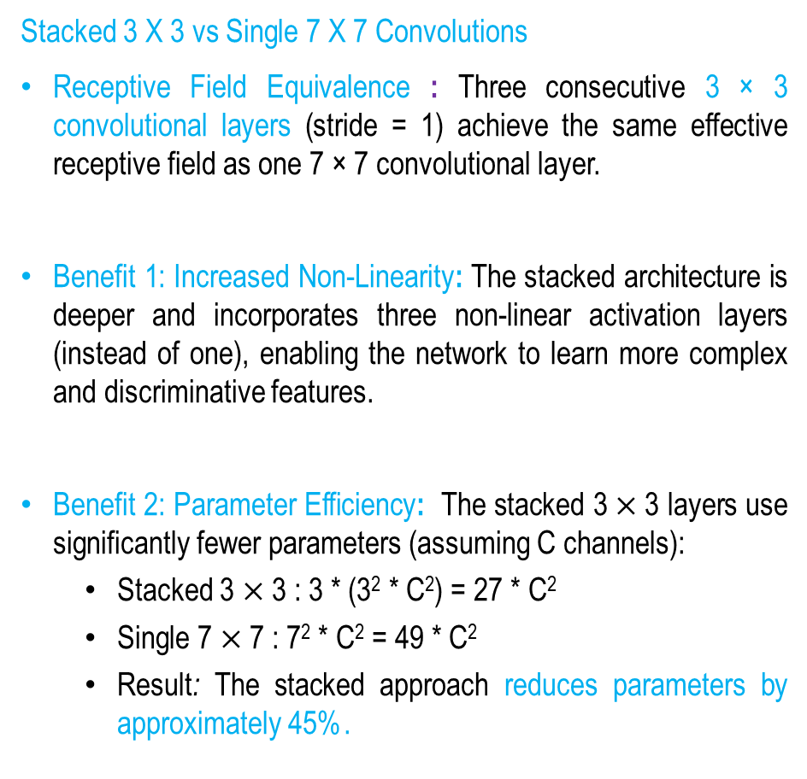
VGG Net
Simonyan and Zisserman 2014
VGG16Net
INPUT
VGG19Net
INPUT
3 X 3 conv + Relu 64
3 X 3 conv + Relu 64
224 X 224
3 X 3 conv + Relu 64
224 X 224
3 X 3 conv + Relu 64
2 X 2 Max – Pool 64
Stacked 3 X 3 vs Single 7 X 7 Convolutions
Receptive Field Equivalence : Three consecutive 3 × 3 convolutional layers (stride = 1) achieve the same effective receptive field as one 7 × 7 convolutional layer.
Benefit 1: Increased Non-Linearity: The stacked architecture is deeper and incorporates three non-linear activation layers (instead of one), enabling the network to learn more complex and discriminative features.
Benefit 2: Parameter Efficiency: The stacked 3 $×$3 layers use significantly fewer parameters (assuming C channels):
  Stacked 3 $×$3 : 3 * (3² * C²) = 27 * C²
  Single 7 $×$7 : 7² * C² = 49 * C²
  Result: The stacked approach reduces parameters by approximately 45%.
2 X 2 Max – Pool 64
3 X 3 conv + Relu 128
3 X 3 conv + Relu 128
3 X 3 conv + Relu 128
112 X 112
112 X 112
3 X 3 conv + Relu 128
2 X 2 Max – Pool 128
2 X 2 Max – Pool 128
3 X 3 conv + Relu 256
3 X 3 conv + Relu 256
3 X 3 conv + Relu 256
56 X 56
56 X 56
3 X 3 conv + Relu 256
3 X 3 conv + Relu 256
3 X 3 conv + Relu 256
3 X 3 conv + Relu 256
2 X 2 Max – Pool 256
2 X 2 Max – Pool 256
3 X 3 conv + Relu 512
3 X 3 conv + Relu 512
3 X 3 conv + Relu 512
3 X 3 conv + Relu 512
28 X 28
28 X 28
3 X 3 conv + Relu 512
3 X 3 conv + Relu 512
2 X 2 Max – Pool 512
3 X 3 conv + Relu 512
2 X 2 Max – Pool 512
3 X 3 conv + Relu 512
3 X 3 conv + Relu 512
14 X 14
3 X 3 conv + Relu 512
3 X 3 conv + Relu 512
14 X 14
3 X 3 conv + Relu 512
3 X 3 conv + Relu 512
2 X 2 Max – Pool 512
3 X 3 conv + Relu 512
2 X 2 Max – Pool 512
7 X 7
FC 4096
FC 4096
7 X 7
FC 4096
FC 4096
FC Output 1000
FC Output 1000
Figure source: Fei Fei Li et. al. Stanford
OUTPUT
OUTPUT

Slide 17
VGG Net
Simonyan and Zisserman 2014
VGG16Net
INPUT
VGG19Net
INPUT
3 X 3 conv + Relu 64
3 X 3 conv + Relu 64
224 X 224
3 X 3 conv + Relu 64
3 X 3 conv + Relu 64
224 X 224
2 X 2 Max – Pool 64
2 X 2 Max – Pool 64
3 X 3 conv + Relu 128
3 X 3 conv + Relu 128
112 X 112
3 X 3 conv + Relu 128
3 X 3 conv + Relu 128
112 X 112
2 X 2 Max – Pool 128
2 X 2 Max – Pool 128
3 X 3 conv + Relu 256
3 X 3 conv + Relu 256
3 X 3 conv + Relu 256
3 X 3 conv + Relu 256
56 X 56
Input : (224 X 224 X3)
Memory : 224 X 224 X3 = 150K, PAM : 0
56 X 56
3 X 3 conv + Relu 256
3 X 3 conv + Relu 256
3 X 3 conv + Relu 256
2 X 2 Max – Pool 256
2 X 2 Max – Pool 256
3 X 3 conv + Relu 512
3 X 3 conv + Relu 512
CONV - (3 X3) - 64 : (224 X 224 X 64)
Memory :224 X 224X 64 = 3.2M, PAM : 3 X 3 X 3 X 64 = 1728
28 X 28
3 X 3 conv + Relu 512
3 X 3 conv + Relu 512
28 X 28
3 X 3 conv + Relu 512
3 X 3 conv + Relu 512
2 X 2 Max – Pool 512
3 X 3 conv + Relu 512
2 X 2 Max – Pool 512
3 X 3 conv + Relu 512
3 X 3 conv + Relu 512
CONV - (3 X3) - 64 : (224 X 224 X 64)
Memory :224 X 224X 64 = 3.2M, PAM : 3 X 3 X 64 X 64 = 36864
14 X 14
3 X 3 conv + Relu 512
3 X 3 conv + Relu 512
3 X 3 conv + Relu 512
3 X 3 conv + Relu 512
14 X 14
2 X 2 Max – Pool 512
3 X 3 conv + Relu 512
7 X 7
2 X 2 Max – Pool 512
FC 4096
FC 4096
7 X 7
Pool – (2 X 2) : (112 X 112 X 64)
Memory : 112 X 112 X 64 = 800K PAM : 0
FC 4096
FC 4096
FC Output 1000
FC Output 1000
OUTPUT
Figure source: Fei Fei Li et. al. Stanford
OUTPUT

Slide 18
Deeper Network
ImageNet Large Scale Visual Recognition Challenge (ILSVRC) winners
Image Source : Hu, Hanqing & Lyu, Jin & Yin, Xiaolin. (2020). Research and Prospect of Image Recognition Based on Convolutional Neural Network. Journal of Physics: Conference Series. 1574. 012161. 10.1088/1742-6596/1574/1/012161.

Slide 19
Google Net
Szegedy et. al. 2014
GoogLeNet, introduced by Christian Szegedy and colleagues in 2014, is a deep convolutional neural network (CNN) that won the ImageNet Large Scale Visual Recognition Challenge (ILSVRC) 2014 by combining high classification accuracy with computational efficiency. It tops the ILSVRC 2014 classification challenge with a 6.7% Top-5 error rate.
The architecture consists of 22 learnable layers and is built around the novel Inception module, which processes input features through multiple parallel branches using 1 × 1, 3 × 3, and 5 × 5 convolutional filters, along with a 3 × 3 max-pooling branch.
The outputs of these parallel operations are concatenated to capture visual information at multiple spatial scales simultaneously.

Slide 20
Google Net
Szegedy et. al. 2014
To reduce computational complexity, GoogLe Net employs 1 × 1 convolutions as bottleneck layers for dimensionality reduction before the computationally expensive 3 × 3 and 5 × 5 convolutions, significantly decreasing the number of parameters. Uses only 5 million parameters—about 12× fewer than AlexNet.
The network accepts 224 × 224 × 3 RGB images as input and replaces large fully connected layers with global average pooling, greatly reducing model size and mitigating overfitting. So, there are no FC layers in this architecture.
Additionally, auxiliary classifiers are attached to intermediate layers during training to improve gradient propagation and regularization.
Owing to its efficient multi-scale feature extraction, reduced parameter count, and improved training strategy, GoogLe Net achieved state-of-the-art performance while using substantially fewer parameters than earlier architectures such as AlexNet and VGGNet, making it a milestone in the evolution of deep convolutional neural networks.

Slide 21
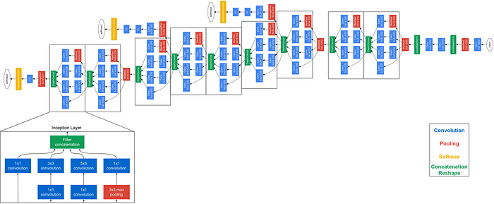
Architecture of Google Net
Szegedy et. al. 2014
Image Source : https://miro.medium.com/v2/resize:fit:720/format:webp/0*q5eMDjUHKqEyo7qY.png

Slide 22
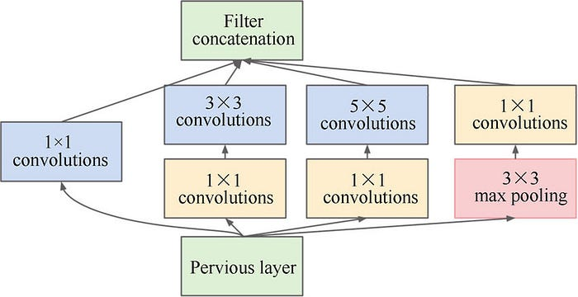
Google Net
Inception Module
The Inception module is the core architectural building block of GoogLeNet (Inception-v1), designed to improve representational power while maintaining computational efficiency.
Image Source : https://miro.medium.com/v2/resize:fit:720/format:webp/0*q5eMDjUHKqEyo7qY.png

Slide 23
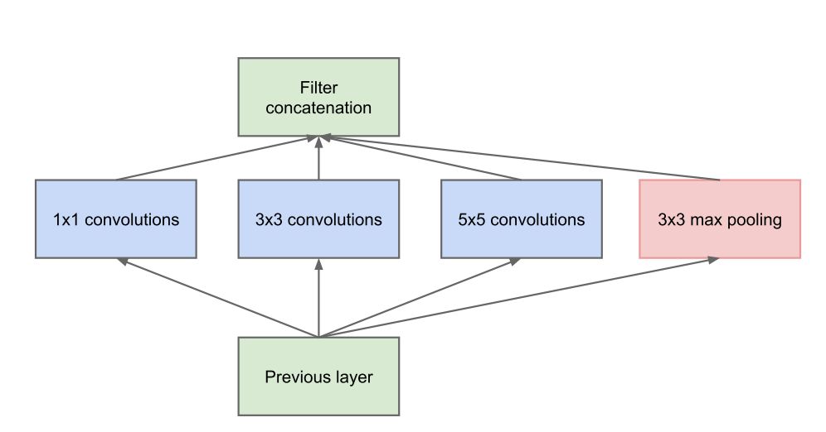
Google Net
Inception Module
Instead of applying a single convolutional filter size, an Inception module performs parallel feature extraction using 1×1, 3×3, and 5×5 convolutions, along with a 3×3 max-pooling branch.
The outputs from all branches are concatenated along the channel dimension, enabling the network to capture multi-scale spatial features within the same layer.
Naive Inception Module Operation
Question: What is the problem with this?
Image Source : https://nicolovaligi.com/articles/history-inception-deep-learning-architecture/inception_module.png

Slide 24
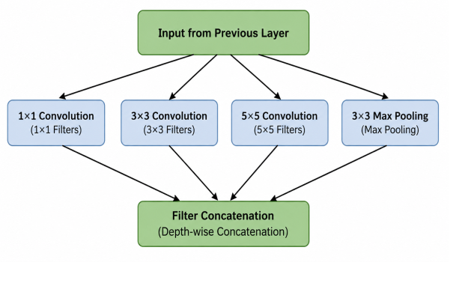
Google Net
Szegedy et. al. 2014
Naive Inception Module Operation :
No. of filters = 128
No. of filters = 192
No. of filters = 96
Module Input : 28 X 28 X 256
Image Source : https://nicolovaligi.com/articles/history-inception-deep-learning-architecture/inception_module.png

Slide 25
Google Net
Szegedy et. al. 2014
Question: What is the output size of all different filter operations?
Computational Cost Analysis
Conv Ops Calculation:
[1x1 conv, 128]: 28x28x128x1x1x256
[3x3 conv, 192]: 28x28x192x3x3x256
[5x5 conv, 96]: 28x28x96x5x5x256
Total: 854M ops
Very expensive compute.
Pooling layer also preserves feature depth, which means total depth after concatenation can only grow at every layer!
No. of filters = 128
No. of filters = 192
No. of filters = 96
28X28X128
28X28X192
28X28X96
28X28X256
Naive Inception Module Operation

Slide 26
Google Net
Szegedy et. al. 2014
Question: What is output size after filter concatenation?
Answer: 28x28x(128 + 192 + 96 + 256) = 28x28x672
Computational Cost Analysis
Conv Ops Calculation:
[1x1 conv, 128]: 28x28x128x1x1x256
[3x3 conv, 192]: 28x28x192x3x3x256
[5x5 conv, 96]: 28x28x96x5x5x256
Total: 854M ops
Very expensive compute.
Pooling layer also preserves feature depth, which means total depth after concatenation can only grow at every layer!
No. of filters = 128
No. of filters = 192
No. of filters = 96
28X28X128
28X28X192
28X28X96
28X28X256
Naive Inception Module Operation

Slide 27
Google Net
Inception Module
To reduce computational cost, 1×1 convolutions are strategically used as bottleneck layers before the computationally expensive 3×3 and 5×5 convolutions, significantly decreasing the number of input channels and reducing parameters and floating-point operations.
*
=
32
6
1
32
6
1
6
6

Slide 28
Bottleneck Layer
2
4
1
6
1
9
8
4
6
8
7
6
A bottleneck layer in a Convolutional Neural Network (CNN) is a low-dimensional intermediate layer that reduces computational cost and the number of parameters by compressing the input feature maps. It is typically implemented using a 1×1 convolution to reduce the channel depth before more computationally expensive operations.
3
2
5
4
6
8
4
5
7
8
3
6
1
9
8
3
7
6
6
2
8
5
7
4
*
2
=
32
4
2
8
…
…
..
32
*
=
6
1
6
1
1 X 1 Convolution reducing channel depth
1 X 1 Convolutions

Slide 29
1 X 1 Convolutions
*
=
32
6
1
32
6
1
6
6

Slide 30
1 X 1 Convolutions
Pixel values from each of the 32 channels are multiplied with corresponding convolution kernel coefficients and are series summed to get one pixel of response matrix.
32
*
32
=
32
6
1
32
6
1
6
6

Slide 31
1 X 1 Convolutions
*
6
=
1
32
32
6
1
6
6

Slide 32
What does 1 X 1 Convolution do?
A 1×1 convolution is used to reduce the channel dimensionality of feature maps without altering their spatial dimensions (height and width).
CONV 1 X 1 X 192
32 Filters
28
32
28
28
192
28

Slide 33
Google Net
Inception Module
GoogLeNet stacks multiple Inception modules hierarchically, allowing the network to learn increasingly abstract and scale-invariant features.
To reduce computational cost, 1×1 convolutions are strategically used as bottleneck layers before the computationally expensive 3×3 and 5×5 convolutions, significantly decreasing the number of input channels and reducing parameters and floating-point operations.
This design addresses the trade-off between network width and computational complexity while preserving expressive capacity.
Image Source : https://miro.medium.com/v2/resize:fit:720/format:webp/0*q5eMDjUHKqEyo7qY.png

Slide 34
Google Net
Szegedy et. al. 2014
Additionally, the architecture incorporates auxiliary classifiers during training to improve gradient propagation and mitigate the vanishing gradient problem.
As a result, GoogLeNet achieved state-of-the-art performance on the ImageNet benchmark with substantially fewer parameters than earlier deep convolutional networks, demonstrating that sparse approximations can be efficiently implemented using dense convolutional operations.
Image Source : https://miro.medium.com/v2/resize:fit:720/format:webp/0*q5eMDjUHKqEyo7qY.png

Slide 35
Google Net
Szegedy et. al. 2014
28 X 28 X 480
Filter
Concatenation
The same parallel branches as in the naïve Inception module are used, but with 1×1 convolutions (64 filters) added as bottleneck layers before the computationally expensive convolutions.
Computational Cost Analysis
Conv Ops Calculation:
  [1x1 conv, 64] 28x28x64x1x1x256
  [1x1 conv, 64] 28x28x64x1x1x256
  [1x1 conv, 128] 28x28x128x1x1x256
  [3x3 conv, 192] 28x28x192x3x3x64
  [5x5 conv, 96] 28x28x96x5x5x64
  [1x1 conv, 64] 28x28x64x1x1x256
Total: 358M ops
28 X 28 X 128
28 X 28 X 192
28 X 28 X 96
28 X 28 X 64
1 X 1
Conv. (128)
3 X 3
Conv. (192)
5 X 5
Conv. (96)
1 X 1
Conv. (64)
28 X 28 X 64
28 X 28 X 64
28 X 28 X 256
1 X 1
Conv. (64)
1 X 1
Conv. (64)
3 X 3
Max Pooling
Previous Layer
Input : 28 X 28 X 256

Slide 36
How 1 X 1 Conv, 64 filter Bottlenecks reduce complexity
The same parallel branches as in the naïve Inception module are used, but with 1×1 convolutions (64 filters) added as bottleneck layers before the computationally expensive convolutions.
Computational Cost Analysis
Conv Ops Calculation:
[1x1 conv, 64] 28x28x64x1x1x256 ; [1x1 conv, 64] 28x28x64x1x1x256 ; [1x1 conv, 128] 28x28x128x1x1x256 ; [3x3 conv, 192] 28x28x192x3x3x64 ; [5x5 conv, 96] 8x28x96x5x5x64 ; [1x1 conv, 64] 28x28x64x1x1x256
Total: 358M ops
Computational Cost Analysis
Conv Ops Calculation:
[1x1 conv, 128]: 28x28x128x1x1x256
[3x3 conv, 192]: 28x28x192x3x3x256
[5x5 conv, 96]: 28x28x96x5x5x256
Total: 854M ops
28 X 28 X 480
Filter
Concatenation
Input: 28X28X256
28 X 28 X 128
28 X 28 X 192
28 X 28 X 96
28 X 28 X 64
1 X 1
Conv. (128)
3 X 3
Conv. (192)
5 X 5
Conv. (96)
1 X 1
Conv. (64)
No. of filters = 128
No. of filters = 192
No. of filters = 96
28 X 28 X 64
28 X 28 X 64
28 X 28 X 256
1 X 1
Conv. (64)
1 X 1
Conv. (64)
3 X 3
Max Pooling
28X28X128
28X28X192
28X28X96
28X28X256
Previous Layer
Input : 28 X 28 X 256
28X28X672
Compared to 854M ops for naive version Bottleneck can also reduce depth to 358M ops after pooling layer

Slide 37
Summary
CNN Architectures
LeNet
AlexNet
VGG Net
Google Net
  Inception Net

Slide 38
CNN Optimization
Next
Lecture 4: Part 3
Generative AI for Computer Vision

